Slide 1

Toronto Bikeshare Data 2017

Slide 2

A
Find out what percentage of bikes are
returned to its initial location?

Slide 3
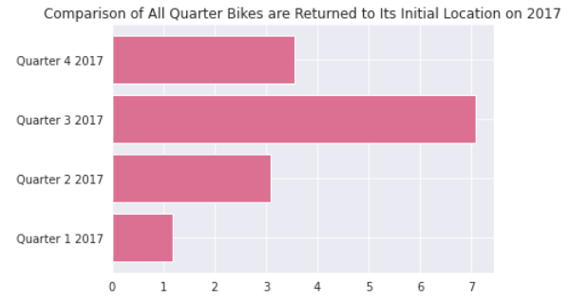
Percentage of bikes are returned to its initial location on 2017
Q1 2017 : 1.17 %
Q2 2017 : 3.08 %
Q3 2017 : 7.08 %
Q4 2017 : 3.57 %
Percentage of bikes are returned to its initial location on 2017 is 0.79 %

Slide 4
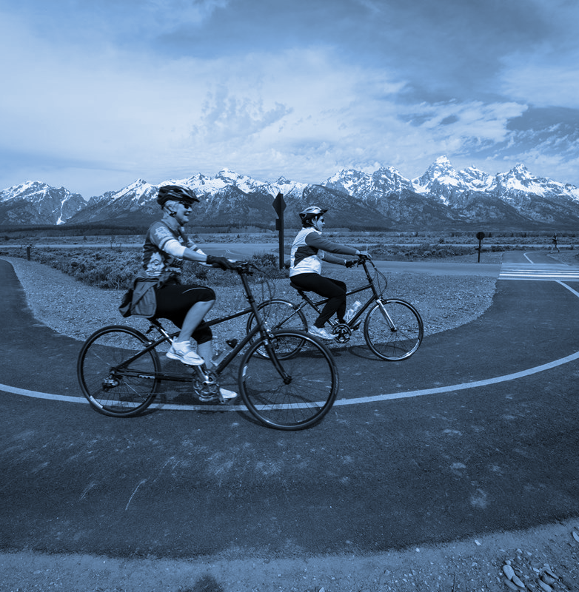
B
When are the peak hours of the day ?

Slide 5
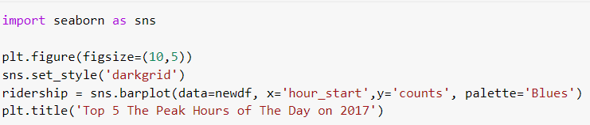
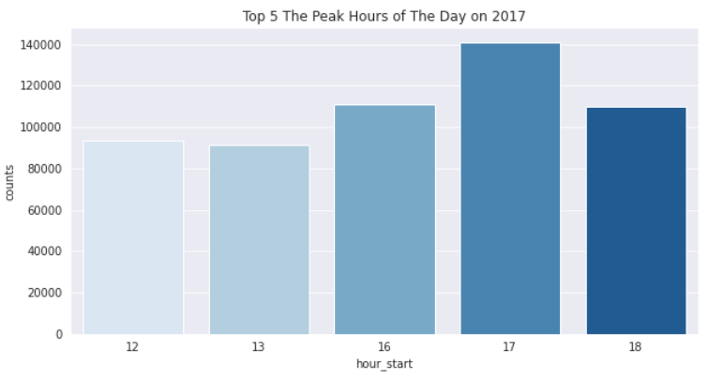
Top 5 The Peak Hours of The Day on 2017
Hour start Count
17:00 140846
16:00 110881
18:00 109930
12:00 93543
13:00 91475
Notes:
Hour start Count
17:00 : 140846
16:00 : 110881
18:00 : 109930
12:00 : 93543
13:00 : 91475

Slide 6
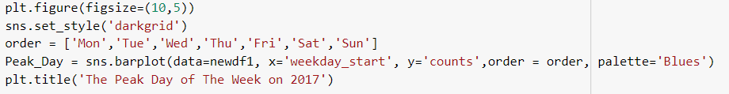
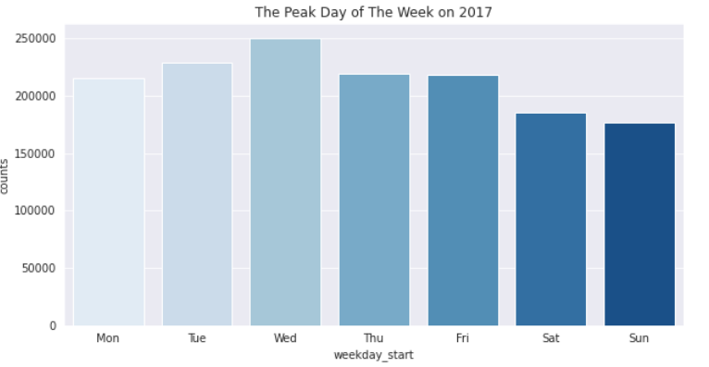
Top 5 The Peak Day of The Week of The Day on 2017
Day Count
Wednesday 249904
Tuesday 228664
Thusday 219422
Friday 217757
Monday 214835
Saturday 185512
Notes:
Tue249904

Slide 7
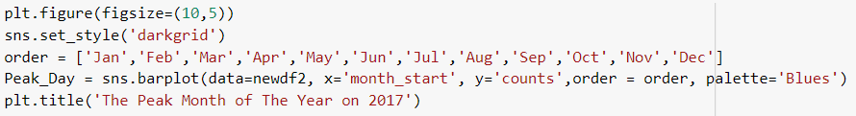
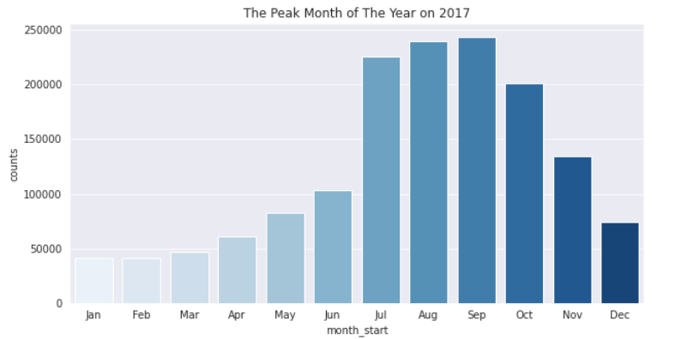
Top 5 The Peak Month of The Year of The Day on 2017
Month Count
Sep 243331
Aug 239242
Jul 225718
Oct 2011899
Nov 1338916
Jun 1028628
Month Count
May 823432
Dec 740770
Apr 610677
Mar 464613
Feb 411814
Jan 41007

Slide 8
C
Which station is the most crowded / needed ?

Slide 9
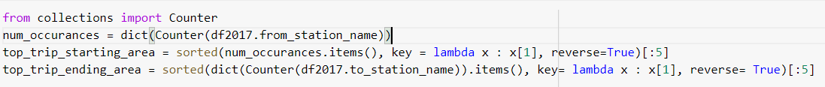
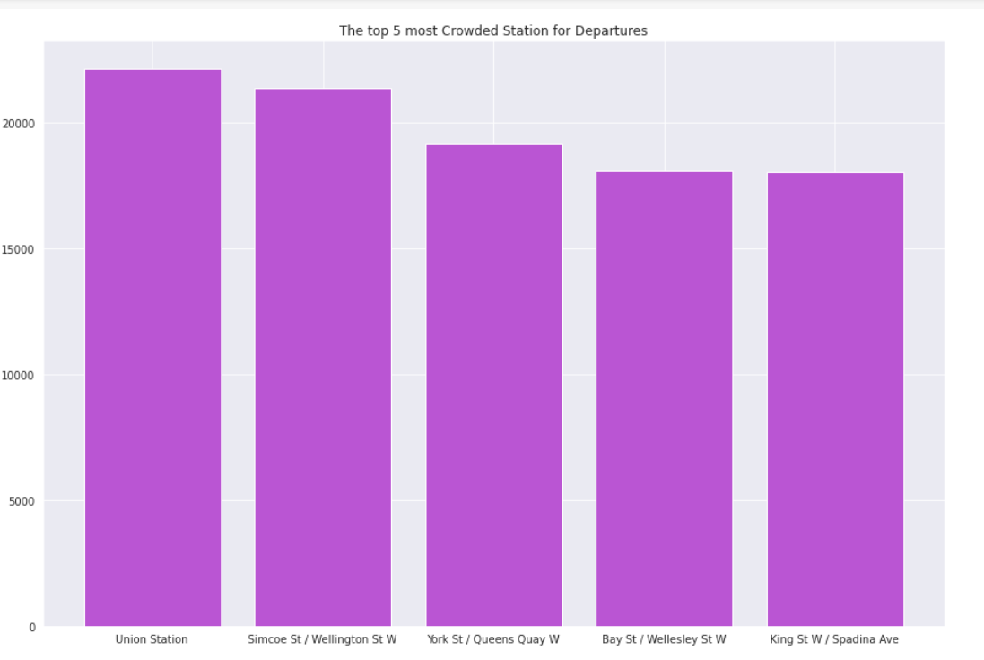
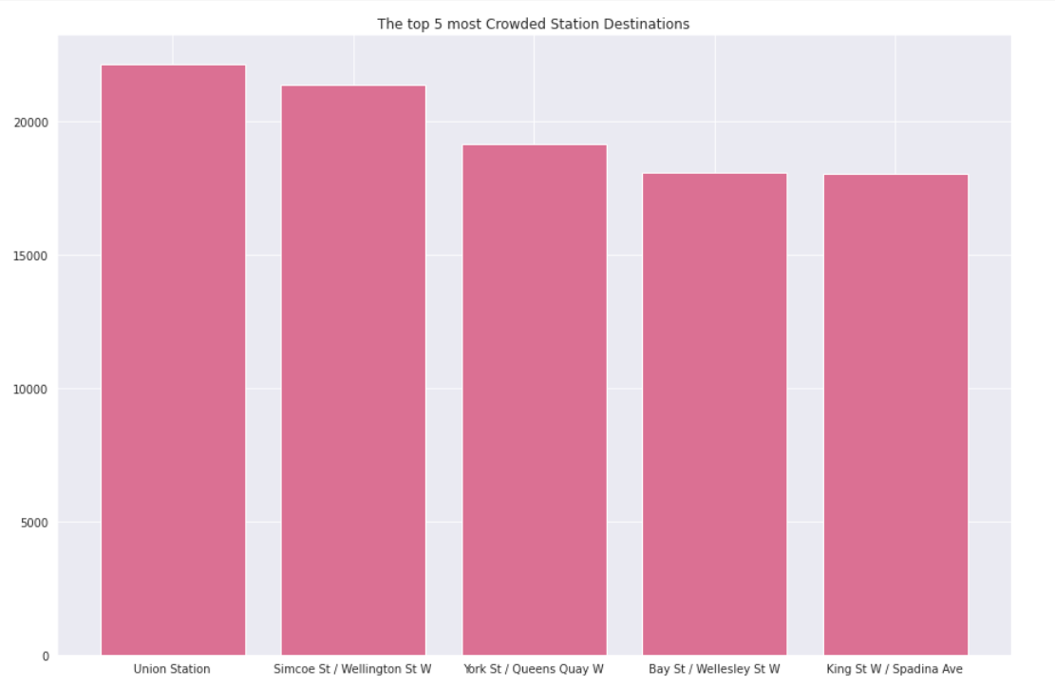
Top 5 Crowded Station on 2017

Slide 10

D
Compare behavior both of user type!

Slide 11
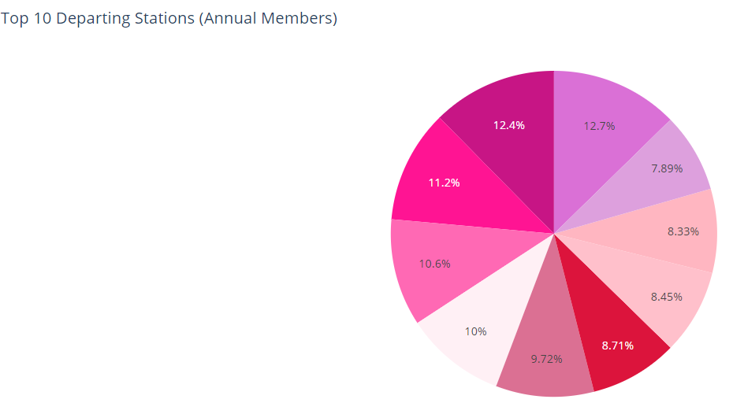
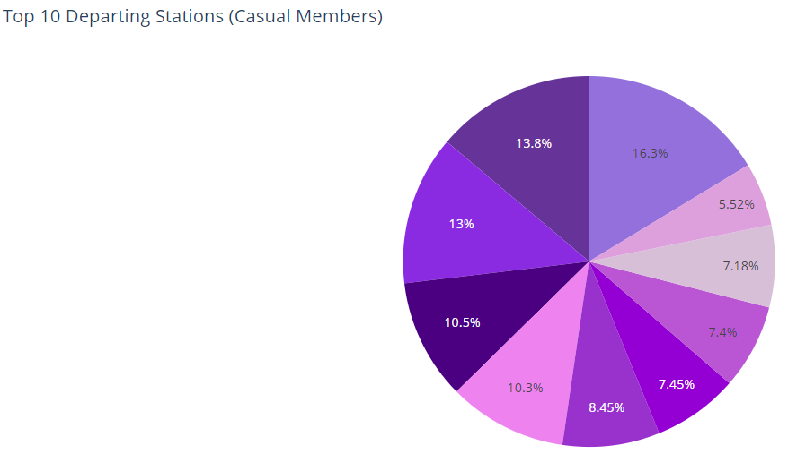
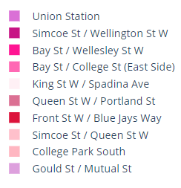
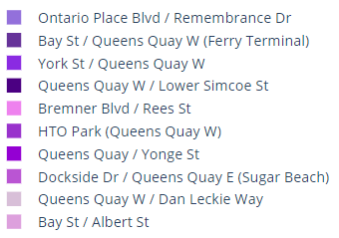
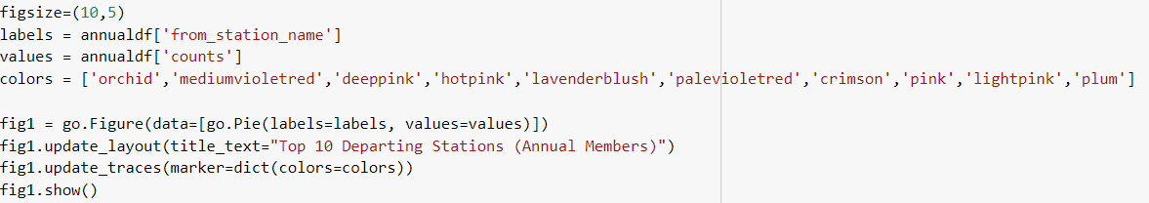
COMPARISON OF THE TOP 10 STATIONS BY USER TYPE

Slide 12
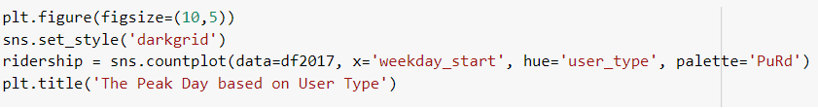
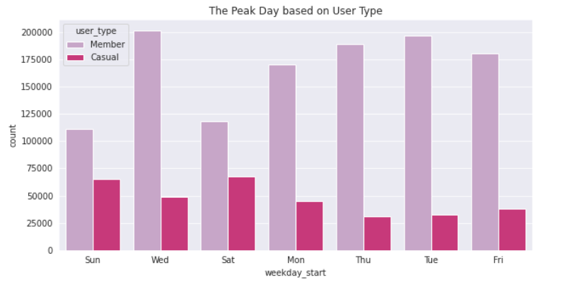
The Peak Day based on
User Type

Slide 13
THANKYOU!

